Slide 1
IDENTIFY EM!
Made by
Sarah Nowlan
Sridhar Ponnusamy
Aleksandr Semenov
Kamakshi Mansukhani
Param Jaswal
I SUPPORT VECTOR MACHINES

Slide 2
Table of Contents
Our Problem
Our Dataset
Data Preprocessing
Libraries and Modeling
Evaluation Metrics
Conclusion

Slide 3
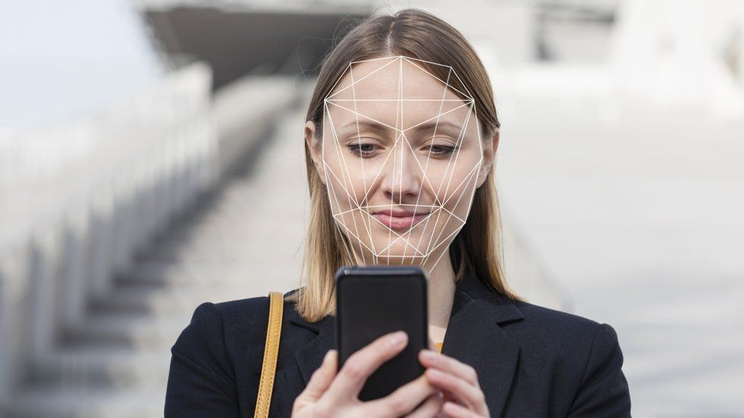
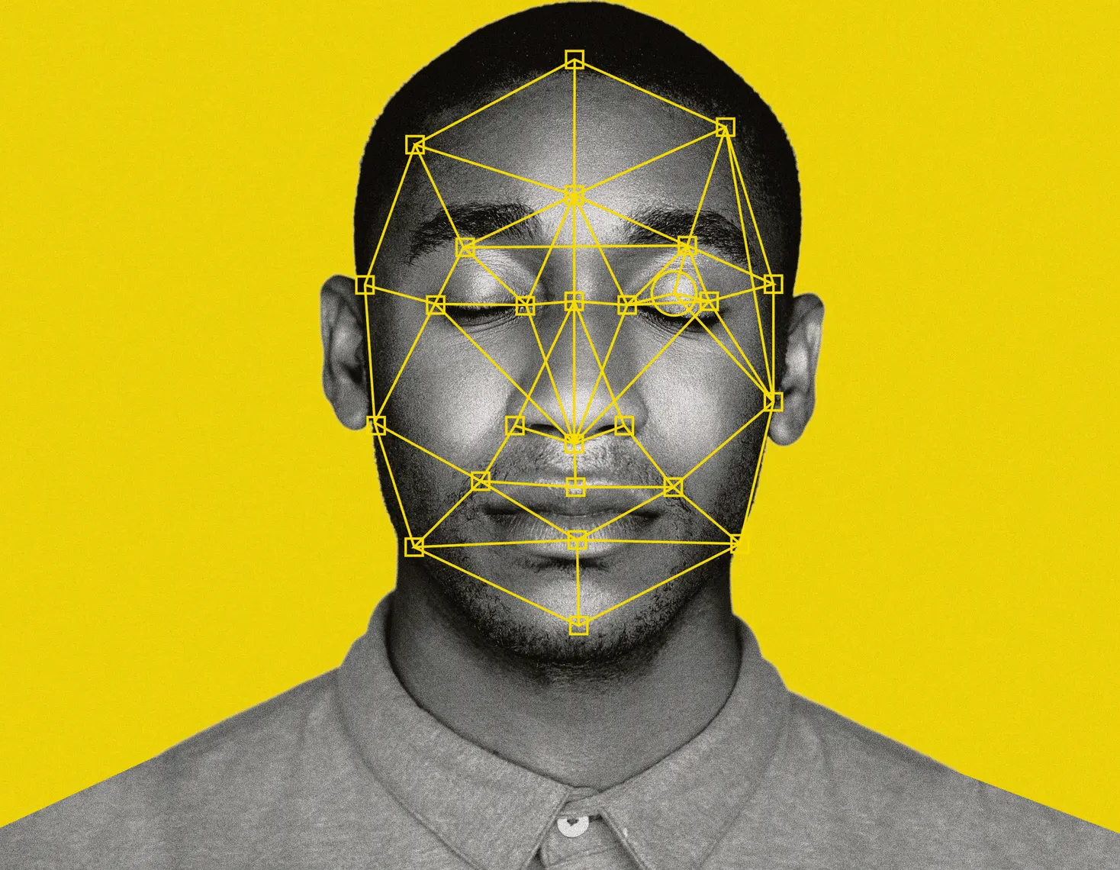
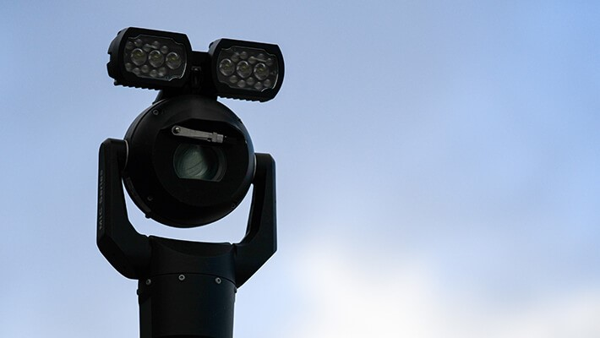
A picture is worth a thousand words
Notes:
Have you ever been stuck in a big queue on the beginning of the work day?
Or maybe you desired a king-size pepperoni pizza, but been always struggling to find cash or credit card to pay for the delivery?
Now, many people create solutions which can be used to make our life easier.
So, we decided to work on a face recognition system.
Our group decided to push ourselves and do a image classification rather then NLP for this project and while we had many struggles with it, we are quite proud of our final product.

Slide 4
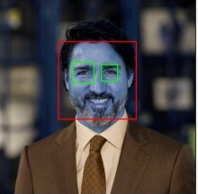

The main target
Our problem was classifying the faces of the leaders of the political parties during the 2021 Canadian federal election.
Notes:
we wanted to make a dataset of faces to classify that had more then 2 classes but not to many that we would struggle to make a good model. We settle on a model that classifieds leaders of the canadian political parties.

Slide 5
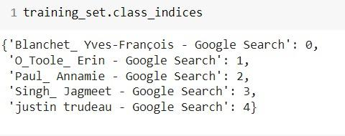
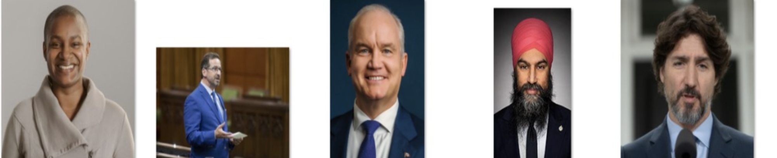
The DataSet
The dataset contains 497 photos
Scraped from the web
equal distribution between the 5 classes
Notes:
We made our dataset by scraping the web for images of our 5 leaders.
Our dataset was not really big, though it contained many photos of 5 different people in different poses.
The class is filled equally with photos, totaling 497 photos over all.
On the side you can see our code were we set the labels for each class to a integer rather then a string.
We assumed that if we can train the system to classify 5 people in almost any situation - we might do so for the whole globe.

Slide 6
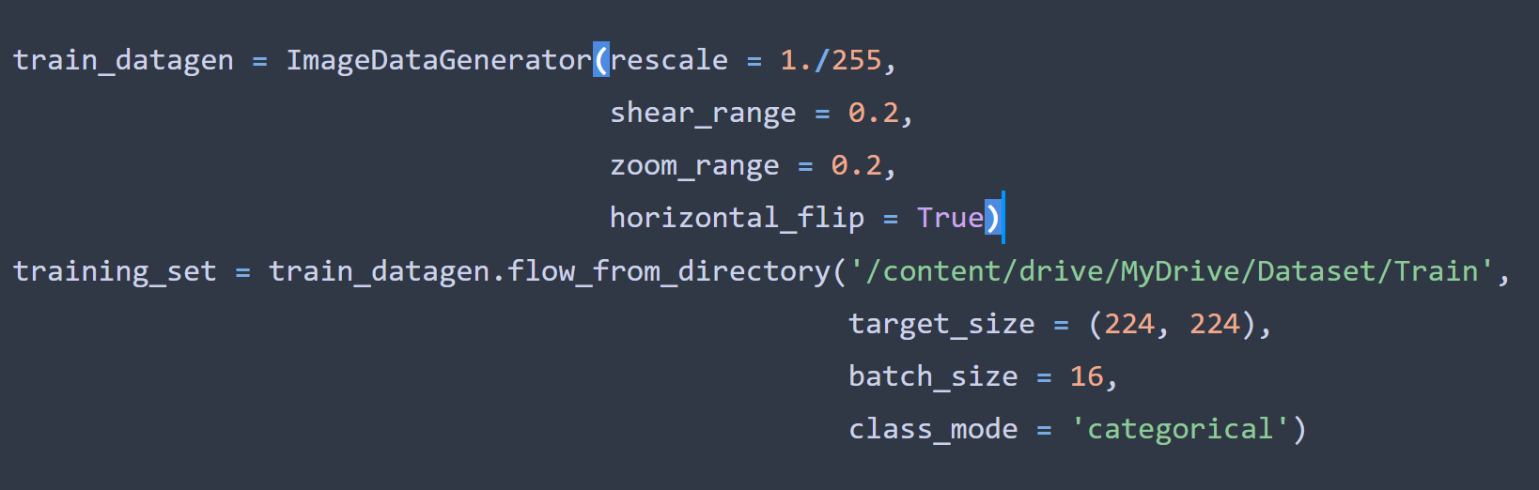
Data Division
The possible classes for the model are Annamie Paul, Jagmeet Singh, Justin Trudeau, Erin O’Tool and Yves-Francois Blanchet.
The training dataset contains 431 images.
The testing dataset contains 66 images.
Notes:
We then split the data into 2 classes: training and testing.
With 431 in training and 66 in testing
Its roughly a 85% to 15% split
After splitting up the dataset we were left with 66 test images, which should be enough to the test.

Slide 7
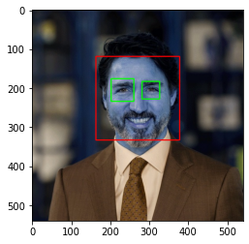
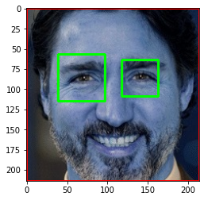
Preprocessing the Data
Detect the face in the photo
Locate the eyes, check that they are in eye constraint
Cascade classifier to detect the eyes and front faces
Photos are removed if both eye can not be located
Notes:
Next was the step of data pre-procession
(Eye constraint being that they are a reasonably located in respect to each other)?????
Meaning when he program detects both eyes, check they are within normal spacing of each other in regards to face.
This way its more likely the program found 2 eyes and is not mistaking some other object as an eye

Slide 8
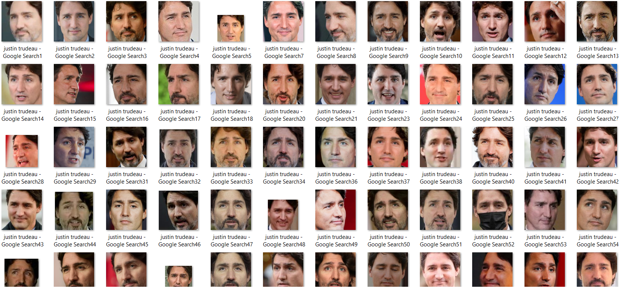
Processing continued
Next we cropped the photos to just contain the faces
removing irrelevant objects
Resized to fit Inception V3 photo constraints

Slide 9
Our Model
Libraries, Modeling

Slide 10
Library
Inception V3 using keras which highly includes transfer learning.
Inception V3 is a widely-used image recognition model that has been shown to attain greater than 78% accuracy on the ImageNet dataset. Based on the paper “Rethinking the inception Architecture for Computer Vision” by Szegedy.
More information on inception V3 can be found on :
https://cloud.google.com/tpu/docs/inception-v3-advanced
Notes:
For the “Training the model” part we used Inception V3 library.
Transfer learning using other an already solved problem and applying the weights and knowledge to a different but similar problem.
We used the imageNet dataset which has been shown to achieve greater than 78% accuracy when being used in transfer learning for image classification.
There are many other libraries such as VGGNet, or ResNet, but we wanted to use the most accurate one, and the Inception is well-known as one of the most accurate & popular libraries.

Slide 11
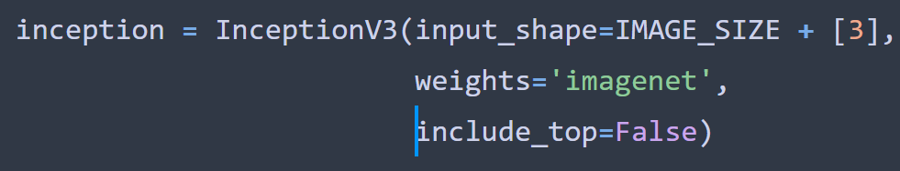
More About Inception V3
ImageNet dataset for weighs:
Over 10 million URLs of labeled images
Million of which have bounding boxes for precise location of labed objects
Inception requires images to be 299X299X3 pixels
Notes:
As for the weights we had a reference of ImageNet dataset, because it contained a lot of similar data to which we were working with, and the predictions were very accurate, so we thought that using this one will work really good.
Also, this explained why we cut the images. The ImageNet dataset has proved that using small images with 300 pixels width & height gives enough information to check all the details & not contain any excessive information.

Slide 12
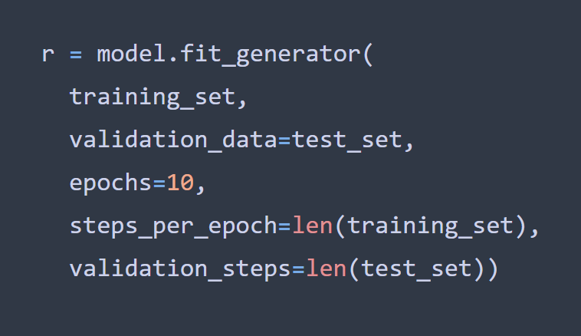
The model training techniques
Small Dataset means transfer learning with pre-trained model will be effective
Implemented early stopping to avoid overfitting
Notes:
With a small dataset like ours, using transfer learning with a pre-trained model will be more effective and more accurate then training a new model with our data set
This reduced training time and required less data to train, which was also effective for our situation.
We used “stopping early” method to avoid overfitting.

Slide 13
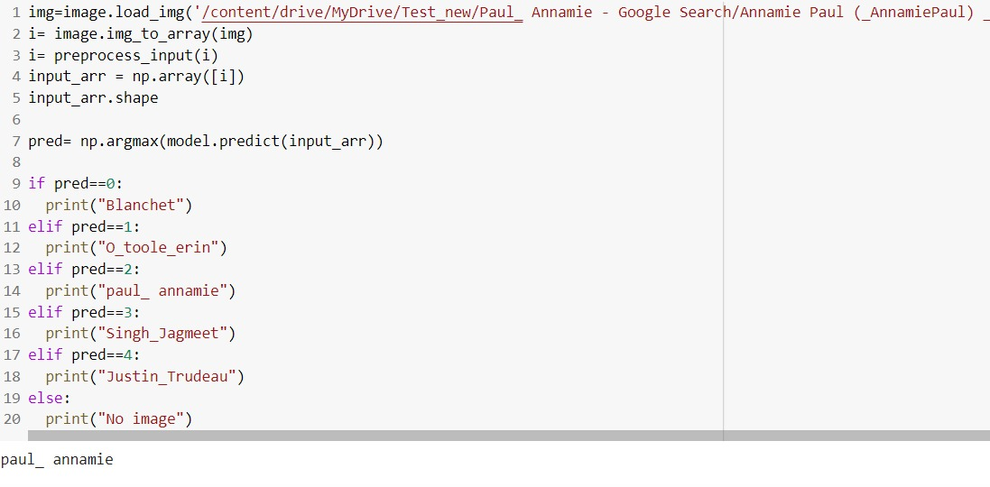
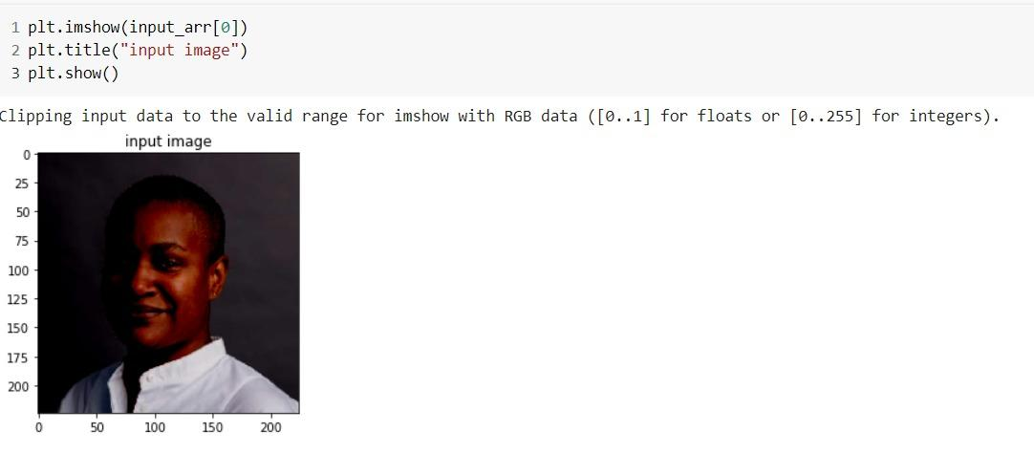
The Running of the Algorithm
Notes:
Our dataset was not really big, though it contained many photos of 5 different people in different poses.
We assumed that if we can train the system to classify 5 people in almost any situation - we might do so for the whole globe.
For our algorithm it was quite comfortable to use if-else switches because we didn’t have many possible results, but for the bigger cases there are solutions many other solutions like hash tables & so on.

Slide 14
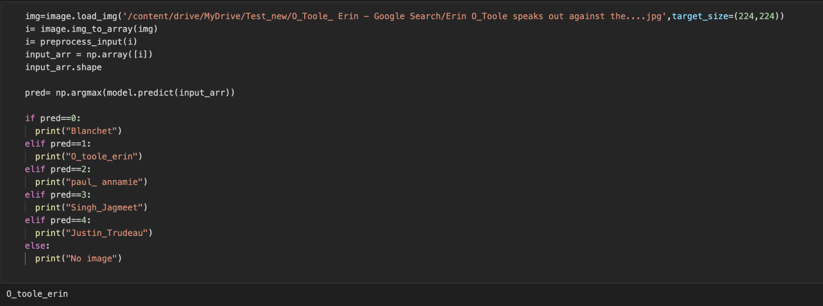
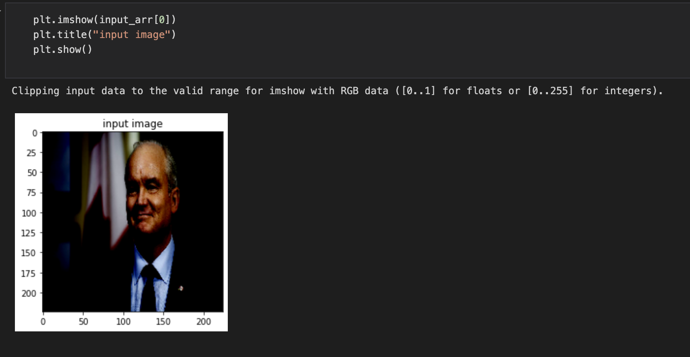
The Running of the Algorithm
Notes:
So these two slides show quite in a good way that sometimes the solution might be quite easy if you’re working on a not-that-big task.
We used a switch of if-else constructions to compare the results of our predictions, because we tried to focus on how to create the fastest algorithm we can.

Slide 15
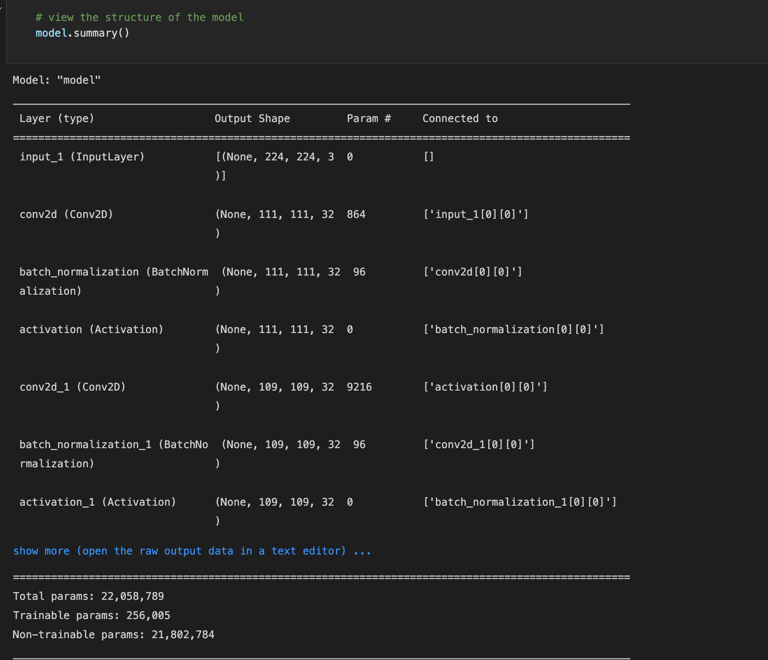
Model Summary
Notes:
Because we used the data visualisation, we had many parameters which we had to - first cut-off, & leave only the trainable ones & then process what we were left with.
In the end we were left with around 250000 trainable parameters which we showed strongly affected our evaluation

Slide 16
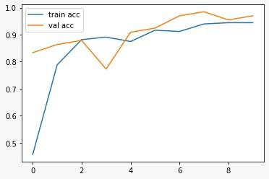
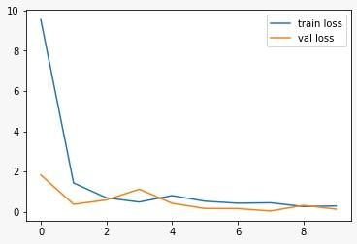
Evaluation Metrics
Plotted Accuracy score:
Plotted Loss Score:
We were able to achieve an accuracy score of 96%
With 5 target classes we decided to use
categorical_crossentropy as the loss metric
Scored with Accuracy because of our highly balanced classes
Notes:
With a Balanced dataset like ours, we decided that we would use accuracy as our evaluation metrics.
After several of our attempts, we were finally able to achieve a 96% accuracy score, which we find good, yet improvable.

Slide 17

Final conclusion
Finn
Alex
Stacy
Kate
Chris
Jake
Notes:
During this project we learned alot about image processing and the difficulties of using a dataset full of web scraped images. After many fails and mistakes over the past couple weeks we ended up with a better evaluation score then we expected.
we found using Inception V3 for image classification is very effective with image classification, for a small dataset giving us a better higher accuracy then we would have achieved training a new model from scratch with our dataset.

Slide 18





This presentation was prepared by wonderful people
Sarah Nowlan
Param Jaswal
Sridhar Ponnusamy
Kamakshi Mansukhani
Aleksandr Semenov

Slide 19
A Closing Joke
Interviewer: What is your biggest strength?
Me: I am an expert in machine learning.
Interviewer: What’s 6 + 10?
Me: Zero.
Interviewer: Nowhere near. It’s 16.
Me: Ok, It’s 16.
Interviewer: What is 10 + 20?
Me: It’s 16.

Slide 20
Thank You for Listening!
Any questions?

